Slide 1
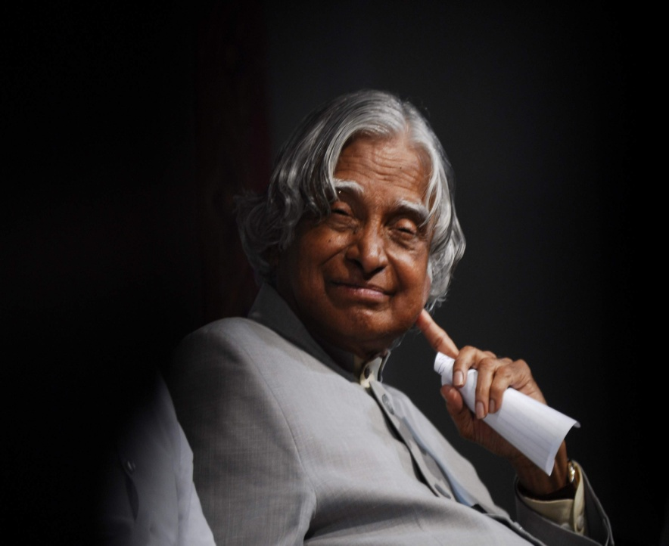
A. P. J. Abdul Kalam

Slide 2
Avul Pakir Jainulabdeen Abdul Kalam
Was an Indian scientist as the 11th President of India from (2002 to 2007) He was born and raised in Rameswaram, Tamil Nadu and studied physics and aerospace engineering. He spent the next four decades as a scientist and science administrator, mainly at the Defence Research and Development Organisation (DRDO) and Indian Space Research Organisation (ISRO) and was intimately involved in India's civilian space programme and military missile development efforts.[1] He thus came to be known as the Missile Man of India for his work on the development of ballistic missile and launch vehicle technology.[2][3][4] He also played a pivotal organisational, technical, and political role in India's Pokhran-II nuclear tests in 1998, the first since the original nuclear test by India in 1974.[5]

Slide 3
Kalam was elected as the 11th President of India in 2002 with the support of both the ruling Bharatiya Janata Party and the then-opposition Indian National Congress. Widely referred to as the "People's President",[6] he returned to his civilian life of education, writing and public service after a single term. He was a recipient of several prestigious awards, including the Bharat Ratna, India's highest civilian honour.

Slide 4
While delivering a lecture at the Indian Institute of Management Shillong, Kalam collapsed and died from an apparent cardiac arrest on 27 July 2015, aged 83.[7] Thousands including national-level dignitaries attended the funeral ceremony held in his hometown of Rameshwaram, where he was buried with full state honours.[8]

Slide 5
Early life and education
Avul Pakir Jainulabdeen Abdul Kalam was born on 15 October 1931 to a Tamil Muslim family in the pilgrimage centre of Rameswaram on Pamban Island, then in the Madras Presidency and now in the State of Tamil Nadu. His father Jainulabdeen was a boat owner and imam of a local mosque;[9] his mother Ashiamma was a housewife His father owned a ferry that took Hindu pilgrims back and forth between Rameswaram and the now uninhabited Dhanushkodi. Kalam was the youngest of four brothers and one sister in his family His ancestors had been wealthy traders and landowners, with numerous properties and large tracts of land. Their business had involved trading groceries between the mainland and the island and to and from Sri Lanka, as well as ferrying pilgrims between the mainland and Pamban. As a result, the family acquired the title of "Mara Kalam Iyakkivar" (wooden boat steerers),

Slide 6
Avul Pakir Jainulabdeen Abdul Kalam was born on 15 October 1931 to a Tamil Muslim family in the pilgrimage centre of Rameswaram on Pamban Island, then in the Madras Presidency and now in the State of Tamil Nadu. His father Jainulabdeen was a boat owner and imam of a local mosque;[9] his mother Ashiamma was a housewife.[10][11][12][13] His father owned a ferry that took Hindu pilgrims back and forth between Rameswaram and the now uninhabited Dhanushkodi.[14][15] Kalam was the youngest of four brothers and one sister in his family.[16][17][18] His ancestors had been wealthy traders and landowners, with numerous properties and large tracts of land.

Slide 7
Their business had involved trading groceries between the mainland and the island and to and from Sri Lanka, as well as ferrying pilgrims between the mainland and Pamban. As a result, the family acquired the title of "Mara Kalam Iyakkivar" (wooden boat steerers), which over the years became shortened to "Marakier." With the opening of the Pamban Bridge to the mainland in 1914, however, the businesses failed and the family fortune and properties were lost over time, apart from the ancestral home.[19] By his early childhood, Kalam's family had become poor; at an early age, he sold newspapers to supplement his family's income

Slide 8
In his school years, Kalam had average grades but was described as a bright and hardworking student who had a strong desire to learn. He spent hours on his studies, especially mathematics.[21] After completing his education at the Schwartz Higher Secondary School, Ramanathapuram, Kalam went on to attend Saint Joseph's College, Tiruchirappalli, then affiliated with the University of Madras, from where he graduated in physics in 1954.[22] He moved to Madras in 1955 to study aerospace engineering in Madras Institute of Technology.[13] While Kalam was working on a senior class project

Slide 9
, the Dean was dissatisfied with his lack of progress and threatened to revoke his scholarship unless the project was finished within the next three days. Kalam met the deadline, impressing the Dean, who later said to him, "I was putting you under stress and asking you to meet a difficult deadline".[23] He narrowly missed achieving his dream of becoming a fighter pilot, as he placed ninth in qualifiers, and only eight positions were available in the

Slide 10
Career as a scientist
After graduating from the Madras Institute of Technology in 1960, Kalam joined the Aeronautical Development Establishment of the Defence Research and Development Organisation (by Press Information Bureau, Government of India) as a scientist after becoming a member of the Defence Research & Development Service (DRDS). He started his career by designing a small hovercraft, but remained unconvinced by his choice of a job at DRDO.[26] Kalam was also part of the INCOSPAR committee working under Vikram Sarabhai, the renowned space scientist.[13] In 1969, Kalam was transferred to the Indian Space Research Organisation (ISRO) where he was the project director of India's first Satellite Launch Vehicle (SLV-III) which successfully deployed the Rohini satellite in near-earth orbit in July 1980; Kalam had first started work on an expandable rocket project independently at DRDO in 1965.[1] In 1969, Kalam received the government's approval and expanded the programme to include more engineers.

Slide 11


